Slide 1
Popular Programming Tech
Part 9
Concurrency with Shared Variables

Slide 2
Learning Objective
LO 1 : Explain fundamental concept of GO Programming Language
LO 2 : Apply GO programming language techniques and libraries
LO 3 : Solve problem using GO programming language

Slide 3
Outline
Race conditions
Mutual exclusion
Read/write mutexes
Memory synchronization
Lazy initialization
The race detector
Goroutinesand threads

Slide 4
In this chapter, we’ll take a closer look at the mechanics of concurrency. In particular, we’ll point out some of the problems associated with sharing variables among multiple goroutines, the analytical techniques for recognizing those problems, and the patterns for solving them. Finally, we’ll explain some of the technical differences between goroutines and operating system threads

Slide 5
Race Conditions
In a sequential program, that is, a program with only one goroutine, the steps of the program happ en in the familiar execution order determined by the program logic
In a program with two or more goroutines, the steps within each goroutine happen in the familiar order, but
in general we don’t know whether an event x in one Goroutine happens before an event y in another goroutine, or happens after it, or is simultaneous with it
A race condition is a situation in which the program does not give the correct result for some interleavings of the operations of multiple goroutines
Race conditions are pernicious because they may remain latent in a program and appear infrequently, perhaps only under heavy load or when using certain compilers, platforms, or architectures. This takes them hard to reproduce and diagnose.

Slide 6
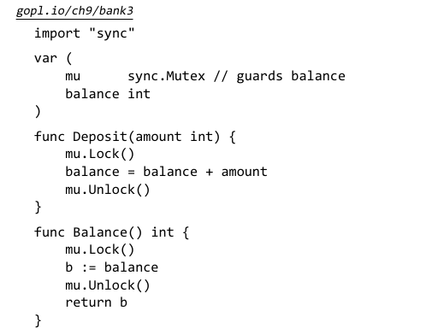
Mutual Exclusion: sync.Mutex

Slide 7
Each time a goroutine accesses the variables of the ban k (just balance here), it must call the mutex’s Lock method to acquire an exclusive lock. If some other goroutine has acquired the lock, this operation will block until the other goroutine calls Unlock and the lock becomes available again. The mutex guards the shared variables. By convention, the var iables guarded by a mutex are declared immediately after the declaration of the mutex itself. If you deviate from this, be sure to document it.

Slide 8
Read/Write Mutexes: sync.RWMutex
A Story: In a fit of anxiety after seeing his $100 deposit vanish without a trace, Bob writes a program to check his bank balance hundreds of times a second. He runs it at home, at work, and on his phone. The bank notices that the increased traffic is delaying deposits and withdrawals, because all the Balance requests run sequentially, holding the lock exclusively and temporarily pre venting other goroutines from running.
Since the Balance function only needs to read the state of the variable, it would in fact be safe for multiple Balance calls to run concurrently, so long as no Deposit or Withdraw call is run-
ning. In this scenar io we need a speci al kind of lock that allows read only operations to proceed in paral lel with each other, but write operations to have fully exclusive access. This lock is called a mu ltiple readers, single writer lock, and in Go it’s provided by sync.RWMutex:

Slide 9
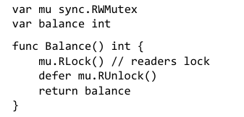
The Balance function now calls the RLock and RUnlock methods to acquire and release a re aders or shared lock. The Deposit function, which is unchanged, calls the mu.Lock and mu.Unlock methods to acquire and release a writer or exclusive lock.

Slide 10
After this change, most of Bob’s Balance re quests run in parallel with each other and finish more quickly. The lock is available for more of the time, and Deposit requests can proceed in a timely manner
RLock can be used only if there are no writes to shared variables in the critical section

Slide 11
Memory Synchronization
In a modern computer there may be dozens of processors, each with its own local cache of the main memory
For efficiency, writes to memory are buffered within each processor and flushed out to main memory only when necessary
Synchronization primitives like channel communications and mutex operations cause the processor to flush out and commit all its accumulated writes so that the effects of goroutine execution up to that point are guaranteed to be visible to goroutines running on other processors.

Slide 12
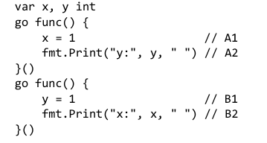

Slide 13

Lazy Initialization: sync.Once
Initializing a variable up front increases the start-up latency of a program and is unnecessary if execution doesn’t always reach the par t of the program that uses that variable

Slide 14
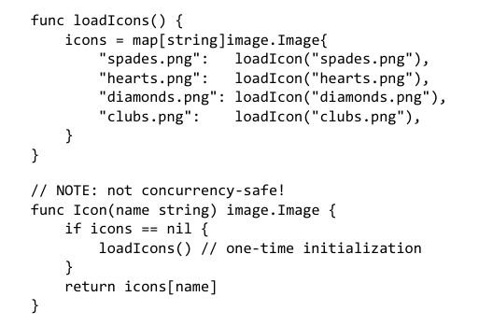
For a variable accessed by only a single Goroutine, we can use the pattern above, but this pattern is not safe if Icon is called concurrently
While the first goroutine is busy loading the icons, another goroutine entering Icon would find the variable still equal to nil, and would also call loadIcons.

Slide 15
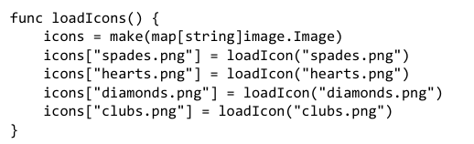
Consequently, a goroutine finding icons to be non-nil may not assume that the initialization
of the variable is complete.

Slide 16
Correct ways
var mu sync.Mutex // guards icons
var icons map[string]image.Image
// Concurrency-safe.
func Icon(name string) image.Image {
mu.Lock()
defer mu.Unlock()
if icons == nil {
loadIcons()
}
return icons[name]
}

Slide 17
The Race Detector
Even with the greatest of care, it’s all too easy to make concurrency mistakes. Fortunately, the Go runtime and toolchain are equipped with a sophisticated and easy-to-use dynamic analysis tool, the race detector.
Just add the -race flag to your go build, go run, or go test command.

Slide 18
Goroutines and Threads Growable Stacks
Each OS thread has a fixed-size block of memory (often as large as 2MB) for its stack, the work area where it saves the local variables of function calls that are in progress or temporarily suspended while another function is called
In contrast, a goroutine starts life wit h a small stack, typically 2KB
A goroutine’s stack, like the stack of an OS thread, holds the local variables of active and suspended function calls, but unlike an OS thread, a goroutine’s stack is not fixe d; it grows and shrinks as needed

Slide 19
Project Progress

Slide 20
References
https://www.golangprograms.com/go-language/concurrency.html

